Slide 1
OBJECT LOCATION DETECTION
USING SONAR

Slide 2
OUR TEAM
Adarsh Pandey (2001EE84)
Shubham Raj (2001EE92)
Vrutant Choudhary (2001EE82)
Medha Singh (2001EE34)
Priya Raj (2001EE46)

Slide 3
TABLE OF CONTENTS
01
02
Objective
Introduction
03
04
Components & Methodology
Results
You can describe the topic of the section here
You can describe the topic of the section here
You can describe the topic of the section here
You can describe the topic of the section here

Slide 4
OBJECTIVE
01
Design a system to detect a object and its location and to alert the users by the location of the object.

Slide 5
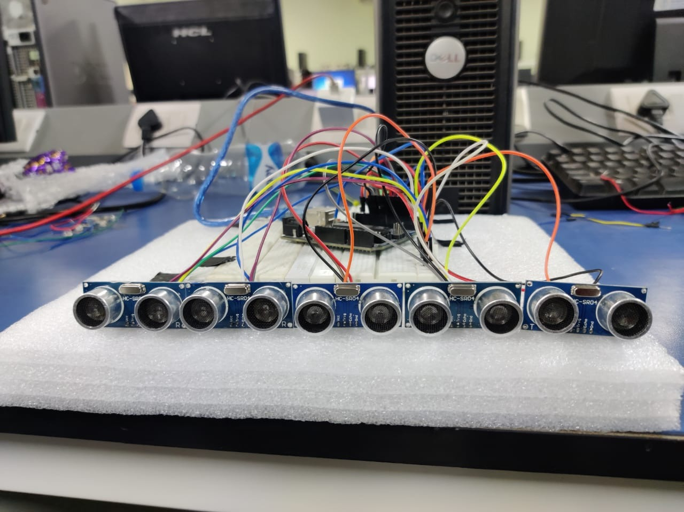
02
INTRODUCTION
The concept of SONAR is used in this project is to detect presence of object and target its position. Targeting mechanism is automated as it uses ultrasonic sensor for detecting the object and its range. Ultrasonic sensor spreads out ultrasonic sound waves (40 KHz) at regular intervals and receives the echo. The echo signals are reflected back to the sensor, when the object is hit. The time that is taken for the ultrasonic waves to spread out and to the distance that is travelled from system to target and back to the system precisely is measured by the Arduino. The calculation of distance to the target is based upon the time-span between emitting the signal and receiving the echo.

Slide 6
03
COMPONENTS & METHODOLOGY

Slide 7
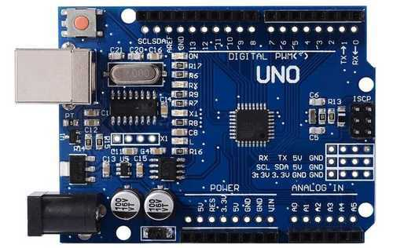
ARDUINO UNO
Micro - Controller
ARDUINO UNO is a microcontroller board that is based on the ATmega328P. Arduino has 14 digital input/output pins (out of which PWM output pins are of 6), 6 analog inputs, 16 MHz quartz crystal, a USB connection port, power jack, an ICSP header and a reset button in it. Everything is contained in it which is needed to support the microcontroller and an USB cable can be used to connect the computer to it and to get it started. The Arduino can be
powered either by AC to DC adapter or by a battery. “Uno” has the meaning of one in Italian and it was used to represent the release of the first version of Arduino Software(IDE). The Uno board and first version of Arduino Software (IDE) were the reference versions of Arduino, now new releases are evolving.

Slide 8
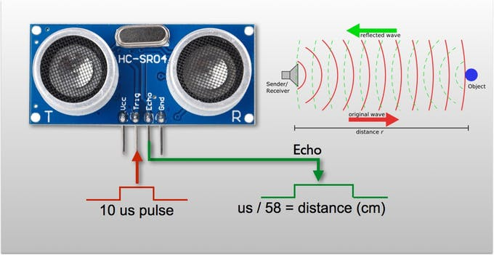
HC - SR04 (Generic)
Ultra-Sonic Sensor
The ultrasonic sensor we are using is the HC-SR04 ultrasonic distance sensor. This economical sensor provides 2cm to 400cm of non-contact measurement functionality with a ranging accuracy that can reach up to 3mm. Each HC-SR04 module includes an ultrasonic transmitter, a receiver and a control circuit.
The four pins of the HC-SR04 are described as: VCC (Power), Trig (Trigger), Echo (Receive), and GND (Ground).
Ultrasonic sensors measure distance by using ultrasonic waves. The sensor head emits an ultrasonic wave (40 KHz) and receives the echo from the target, which measures the distance to the target by measuring the time between the emission and reception.
Total five HC-SR04 is used in an array form to increase the accuracy and range.

Slide 9
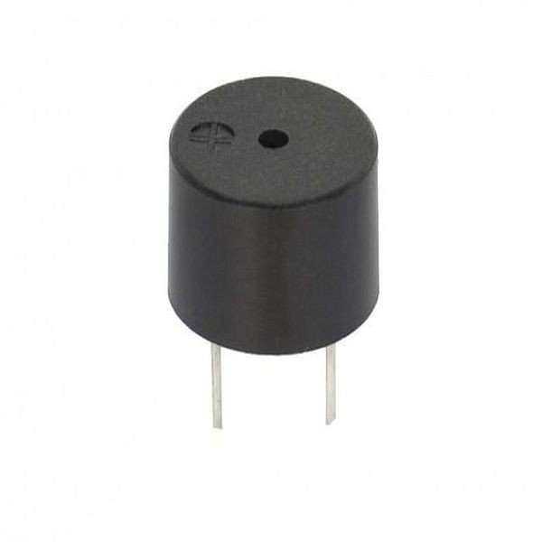
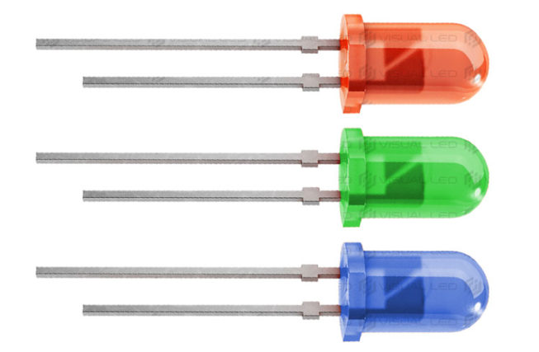
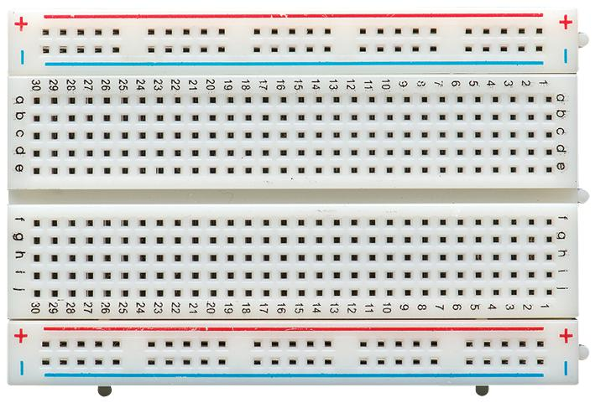
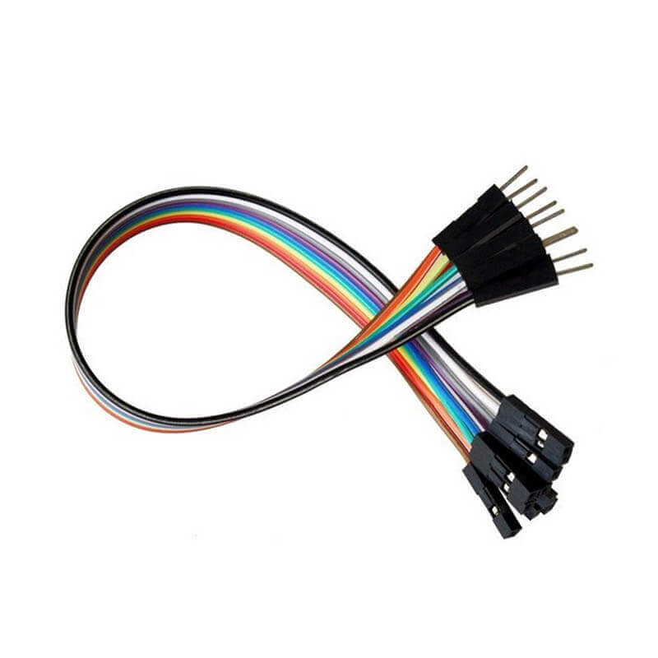
OTHER COMPONENTS
PIEZO BUZZER
LED
Breadboard
Jumper wires

Slide 10
METHODOLOGY
WORKING PRINCIPLE
The Ultrasonic sensor emits high frequency sound waves at regular time intervals as the velocity of sound in air. The waves fall on the object and get reflected back to the receiver. Time duration of the pulse emitted and received is noted and the distance of the object is calculated. This principle is called SONAR.
Five ultrasonic sensors are connected in an array.
The sensor emits waves of frequency about 40KHz and it can cover up to a range of 2m.
As soon as an object comes under the range of the sensors each sensor measures the time duration while transmitting and receiving the ultrasonic waves.
By using the formula s=(t/2)*(speed of sound) the distance is calculated, where speed of sound in non-humid air at 20 degrees Celsius is about 3.43 centimetres per second.
When the object gets too close to the base i.e. distance<=15 cm the LED starts glowing and the buzzer beeps simultaneously.
An array of sensors give no delay to measure positional distance of a huge area in front of the array.
All these data are processed by the ARDUINO UNO.
The code written in ARDUINO is in C/C++ language and this code embedded to the IDE the system.

Slide 11
METHODOLOGY
Once the code is uploaded and compiled, the sensors detects the objects and sends the data to the ARDUINO.
Distance is calculated and displayed in ARDUINO IDE terminal.
Buzzer and LED gets active showing the close proximity of the object detected.

Slide 12
RESULT
04
The sensor consists of 4 pins Vcc, Trig, Echo and Gnd which are connected to the Arduino UNO pins 5V, 2,3 and Gnd respectively. Similarly, four other sensors are connected.
The sensor measures the time duration and sends it to the Arduino then the distance is calculated through the formula used in the code embedded.
Also, when object is within the range of 15 cm, LED (connected to pin 12) and the buzzer (connected to pin 13) connected to the circuit starts responding.
The project has been successfully designed and tested, and the desire of the project is accomplished without any discrepancy.
Since this project has many security values, the future scope for this project is high.

Slide 13
This project can be used for detecting enemy location with a great precision by technologically advancing it.
This is limited to detect the large object only with great accuracy. In future it can be made to detect locations small objects too. This can be done by implementing the more number of sensor array in stack form focusing on a particular location.
This project detects the location at a room temperature i.e 20 degree Celsius. It can be made to work at any temperature by implementing a Thermocouple, RTD (Resistance Temperature Detectors) etc, which senses the temperature and according to it speed of sound changes and distance can be calculated.
FUTURE ASPECTS OF THE PROJECT

Slide 14
THANKS

